Slide 1


.NET Core
SURESH KANCHAMREDDY, ANIMESH BULUSU, KUMAR UPPE, SRAVAN GUMPENA, MAHESH PULLAGURA, MAHESH GALI, RAJESH PRASAD
July 2019

Slide 2
AGENDA
Introduction
dotnet CLI, packages and deployment
Middleware and Dependency Injection
ASP.NET Core with MVC #1
ASP.NET Core with MVC #2
ASP.NET Core Advanced Topics
Web API
Conclusion
Notes:
Internationalization

Slide 3
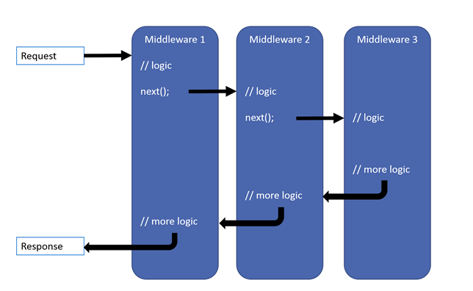

MIDDLEWARE
Middleware is software that is assembled into an application pipeline to handle requests and responses. MVC 6 is configured as middleware In ConfigureServices via AddMvc In Configure via UseMvc Has access to both Request and Response May simply pass the request to next middleware May process the request and then pass to next middleware May handle the request and short-circuit the pipeline Middleware are executed in the order they are added

Slide 4
Configure Request Processing Pipeline
Information logged
Mw1:Incomming request
Mw2:Incomming request
Mw3:outgoing request
Mw2:outgoing request
Mw1:outgoing request
https://github.com/aspnet/MetaPackages/blob/release/2.2/src/Microsoft.AspNetCore/WebHost.cs
UseKestrel

Slide 5
Static files in asp net core
By default an .Net core application will not serve static files
The default directory for static files is wwwroot
To serve static files UseStaticFiles() middleware is required
To server static files UseDefaultFiles() middleware is required
The following are the default files
Index.html
Index.htm
Default.html
Default.htm
UseDefaultFiles() must be register before UseStaticFiles()
UseFileServer() combines the functionality UseDefaultFiles() , UseStaticFiles() and UseDirectoryBrowser()

Slide 6

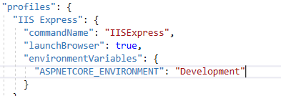
Environment variables
ASPNETCORE_ENVIRONMENT variable set the runtime environment
On development machine we set it in launchSettings.json
On staging or production we set in the operating system environment.
Runtime environment default value is Production
In addition to standard environments, custom environments like UAT,QA also supported by using env.IsEnvironment("UAT") method

Slide 7
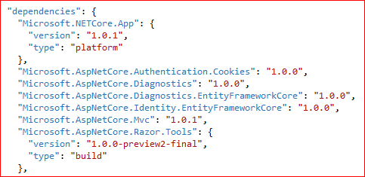
GETTING STARTED ….
Project.json
To Manage server-side dependencies
Startup.cs
IConfigurationRoot
ConfigureServices()
Configure()

Slide 8
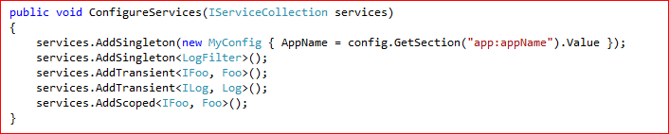
DEPENDENCY INJECTION
Register dependencies in Startup.cs from ConfigureServices() method
Services.AddSingleton()
Services.AddTransient()
Services.AddScoped()
Can use thirdparty dependency frameworks in ConfigureServices() method

Slide 9
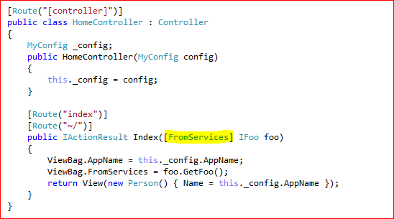
DEPENDENCY INJECTION
Can inject dependencies into controllers via
Constructor
Action parameters via [FromServices]

Slide 10
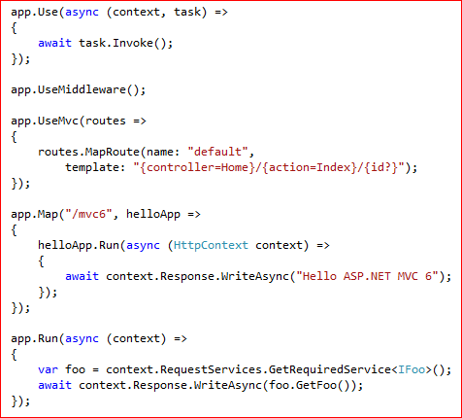
APPLICATION STARTUP
app.Use()
app.UseMiddleware()
app.UseMvc()
app.Map()
app.Run()

Slide 11
DEMO

Slide 12
Q and A

Slide 13
Thank You

